Slide 1
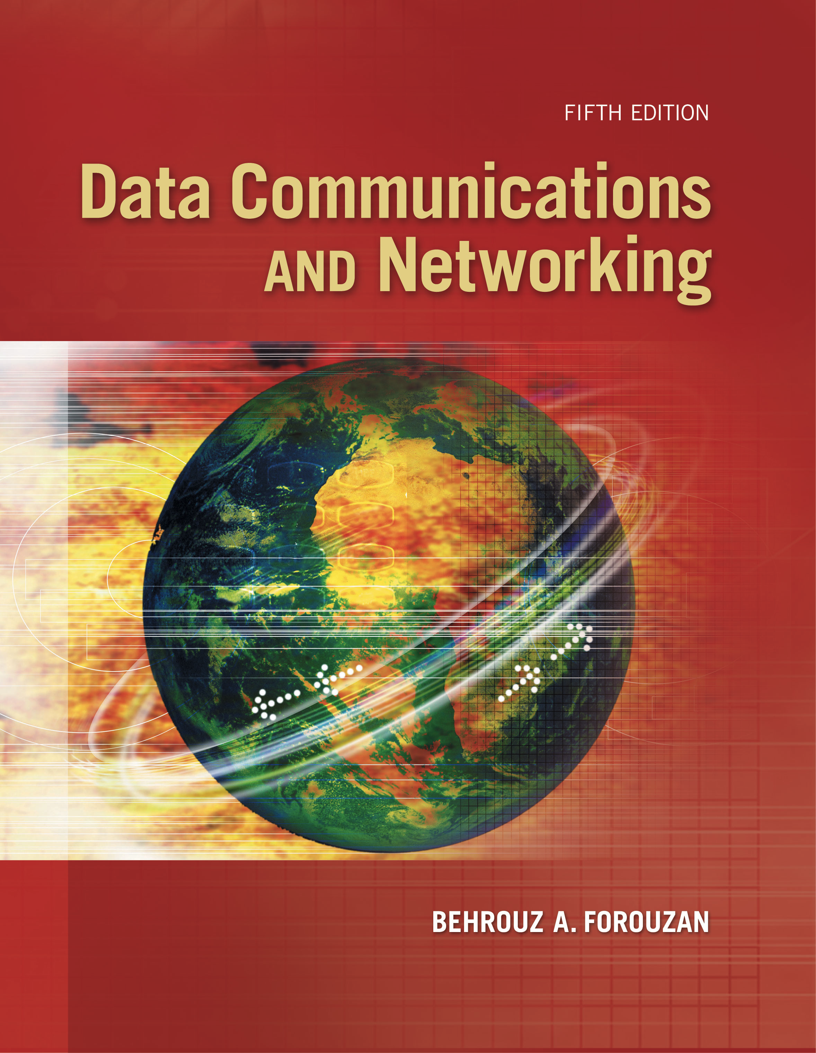
Computer Networks
Connecting Devices
S.V.Jansi Rani
Associate Professor / CSE

Slide 2
AGENDA
Connecting Devices
Hubs
Link layer Switches
Routers

Slide 3
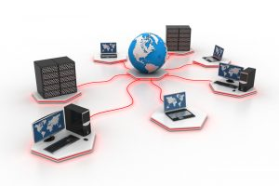


Slide 4
Connecting Devices

Slide 5
Connecting Devices
Hosts and networks do not normally operate in isolation.
Connecting devices to connect hosts together to make a network or to connect networks together to make an internet.
Connecting devices can operate in different layers of the Internet model.
Three kinds of connecting devices:
Hubs
Link-layer switches
Routers

Slide 6
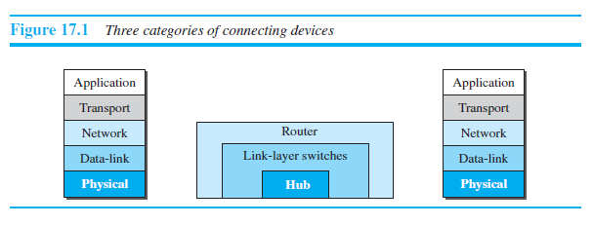
Connecting Devices

Slide 7
Connecting Devices
Hub -physical layer
Signals that carry information
within a network can travel a fixed distance before attenuation endangers the integrity
of the data. A repeater receives a signal and, before it becomes too weak or corrupted,
regenerates and retimes the original bit pattern. The repeater then sends the refreshed
signal. In the past, when Ethernet LANs were using bus topology, a repeater was used
to connect two segments of a LAN to overcome the length restriction of the coaxial
cable. Today, however, Ethernet LANs use star topology. In a star topology, a repeater
is a multiport device, often called a hub, that can be used to serve as the connecting
point and at the same time function as a repeater. Figure 17.2 shows that when a
packet from station A to station B arrives at the hub, the signal representing the frame
is regenerated to remove any possible corrupting noise, but the hub forwards the

Slide 8
Connecting Devices
Hosts a

Slide 9
Connecting Devices
Hosts a

Slide 10
Connecting Devices
Hosts a

Slide 11
Connecting Devices
Hosts a

Slide 12
Connecting Devices
Hosts a

Slide 13
Connecting Devices
Hosts a

Slide 14
Connecting Devices
Hosts a

Slide 15
Connecting Devices
Hosts a

Slide 16
Connecting Devices
Hosts a

Slide 17
Connecting Devices
Hosts a

Slide 18
Connecting Devices
Hosts a

Slide 19
Connecting Devices
Hosts a

Slide 20
Connecting Devices
Hosts a

Slide 21
Connecting Devices
Hosts a

Slide 22
Connecting Devices
Hosts a

Slide 23
Connecting Devices
Hosts a

Slide 24
Connecting Devices
Hosts a

Slide 25
Radio Layer
Modulation
Bluetooth uses a sophisticated version of FSK, called
GFSK (FSK with Gaussian bandwidth filtering).
GFSK has a carrier frequency. Bit 1 is represented by a frequency deviation above the carrier; bit 0 is represented by a frequency deviation below the carrier.
The frequencies, in megahertz, are defined according to the following formula for each channel.
F_{c} = 2402 + n MHz , n = 0,1,2 3….,78
For example, the first channel uses carrier frequency 2402 MHz (2.402 GHz)
second channel uses carrier frequency 2403 MHz (2.403 GHz).

Slide 26
Check Your Understanding
What is the basic unit of bluetooth
Which flow control protocol is used in Bluetooth?

Slide 27
Outcome
Student should be able to
Explain the Bluetooth technology

Slide 28
THANK YOU

